Slide 1
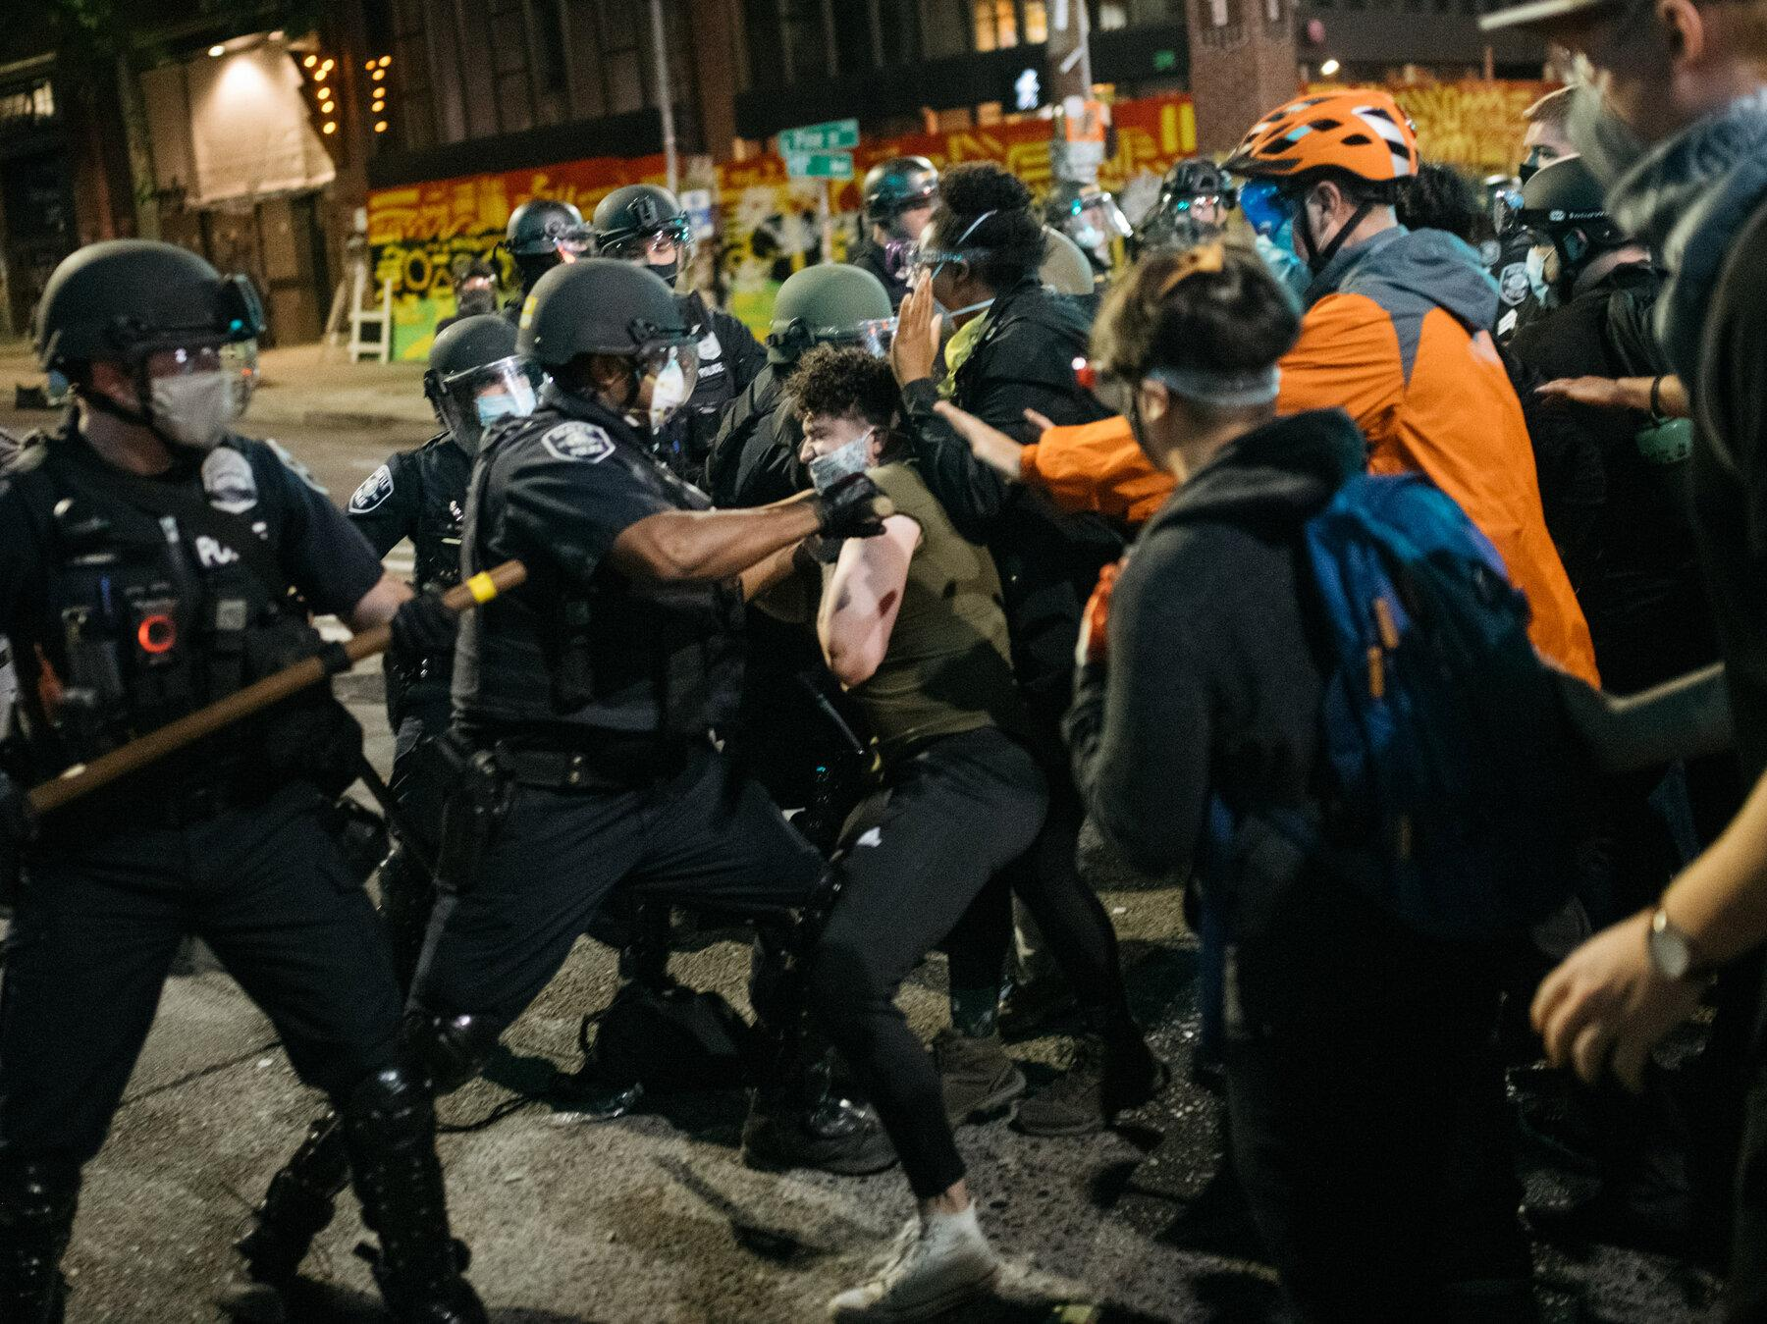
Complaints Against NYC Police Officer
By: Jacky Ma
Tanvir Enam
Barbara Nah
Cole Encarnacion
Notes:
For our data project, we chose to talk about ^^ And it’s gonna be presented by

Slide 2

AGENDA
Background
Observations/Insights
Recommendations
Sources & Appendix
Notes:
The breakdown for our data project will go over the background, observations~~these

Slide 3
Background

Slide 4
Background
A database breakdown to show complaints against police officers in NYC .
Given the nature of their work, police officers enjoy considerable levels of discretion; nonetheless, this could result in abuse of authority, which mostly affect civilians.
Police officers race/background could play a potential role in why they act unlawfully.

Slide 5
Observations & Insights

Slide 6
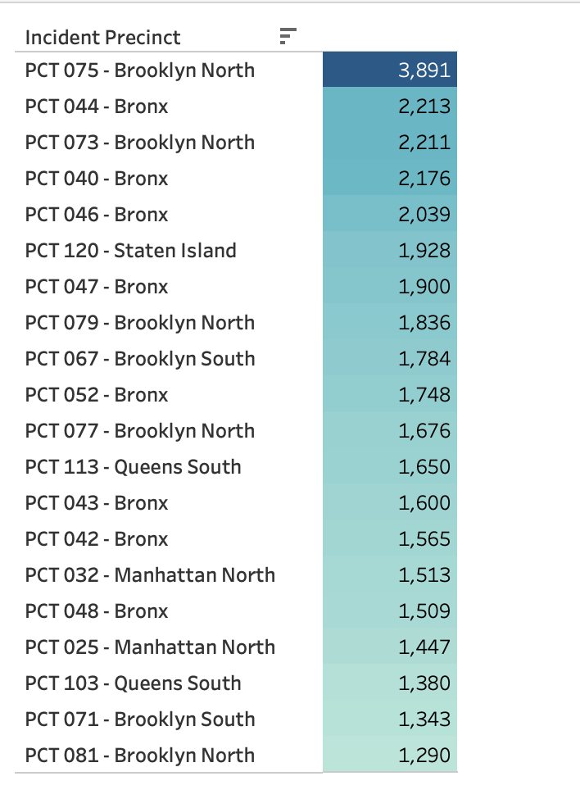
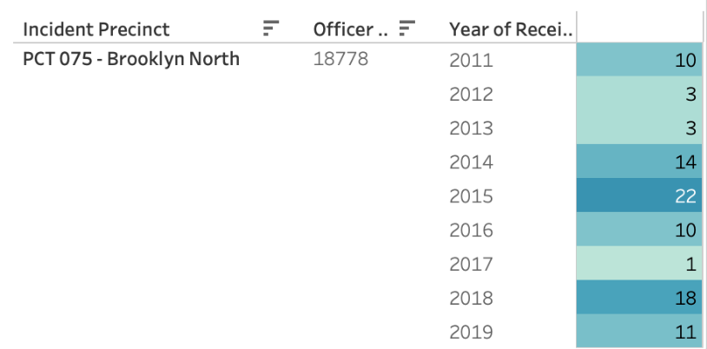
HIGHEST COMPLAINTS AMONG TOP 20 PRECINCTS
(2011-2019)
Total # of Complaints
PCT 075 - Brooklyn North
Bronx: 8/20
Brooklyn: 7/20
Manhattan: 2/20
Queens: 2/20
Staten Island: 1/20
Sergeant Martinez
Notes:
The following information is based on a timeline from 2011 to 2019
According to our data, the 20 precincts with the highest amount of complaints against them are revealed in the table displayed from greatest to least
With Precinct 075 in first place with 3,891 complaints over the span of nine years
The largest number of complaints received against one officer in that was 92 – 22 of those complaints occurring in one year (2015) (hispanic male)
Precinct 75 is located in Brooklyn, the second borough with the most amount of complaints against their precincts–
The Bronx being in first place, with Manhattan and Queens in third place but significantly lower

Slide 7
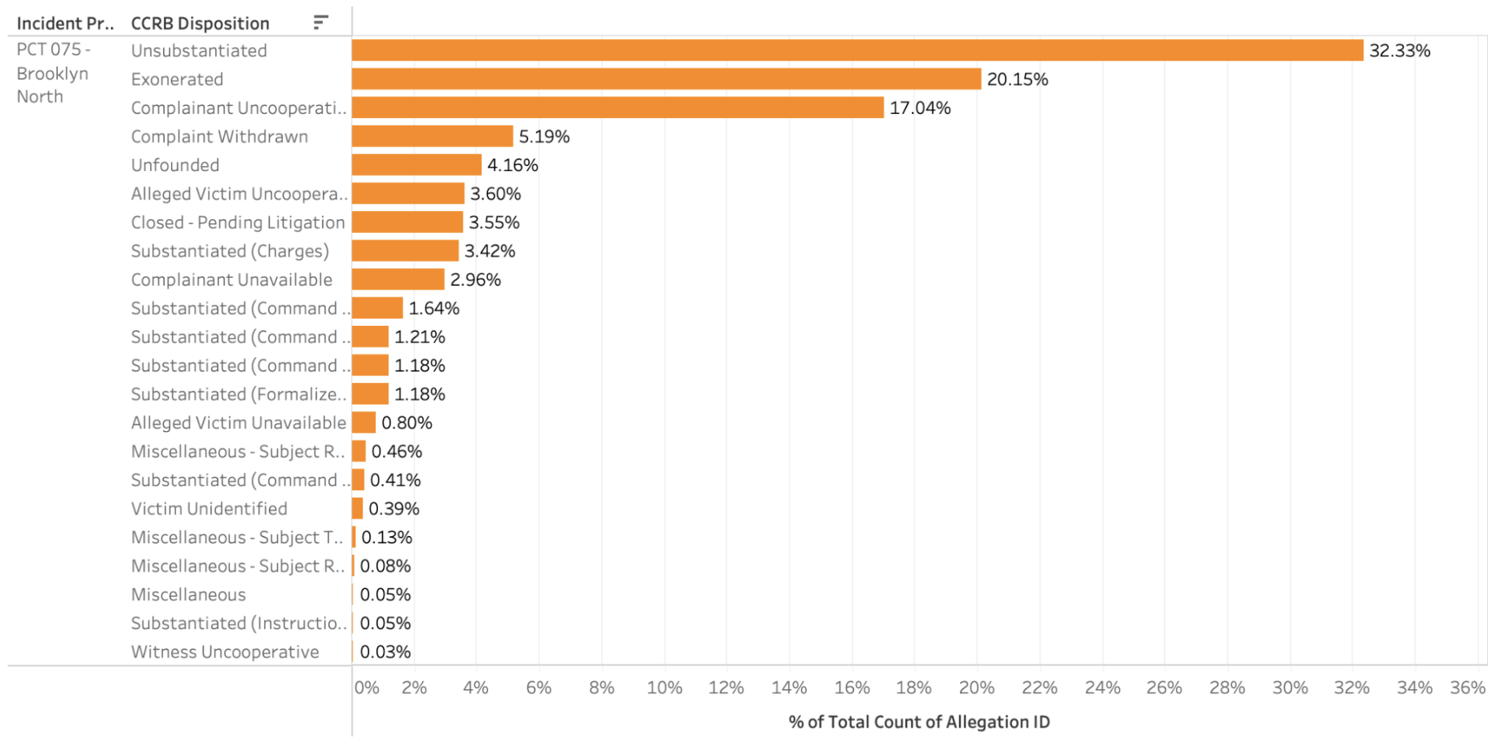
The Outcomes of Reported Complaints at Precinct 075

Slide 8
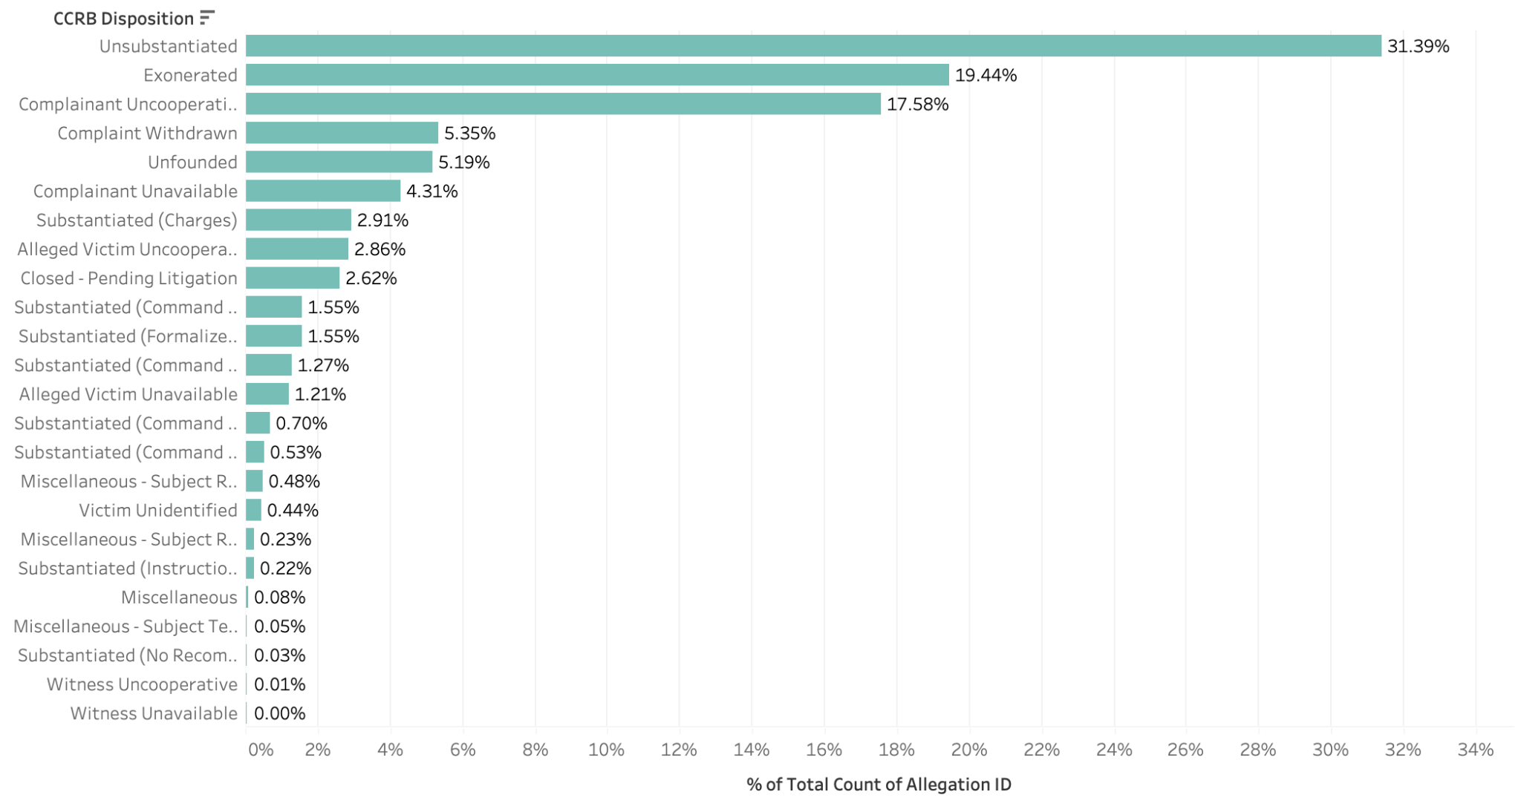
The Outcomes of Reported Complaints against Officers in General

Slide 9
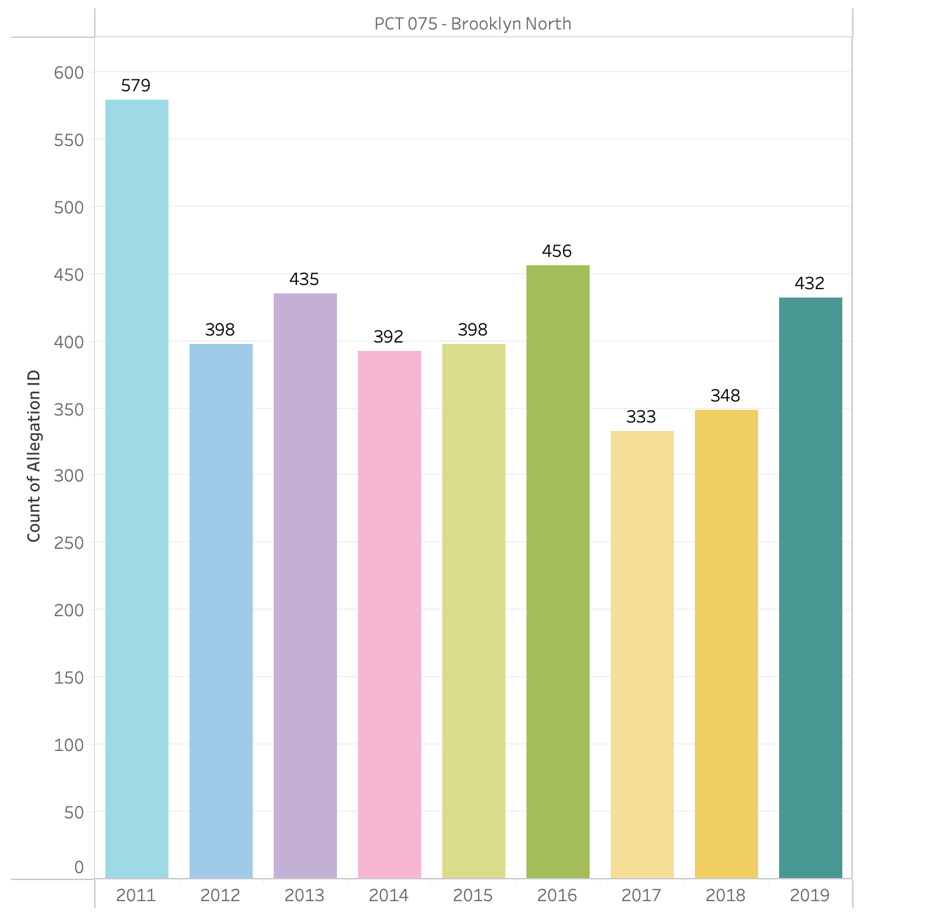
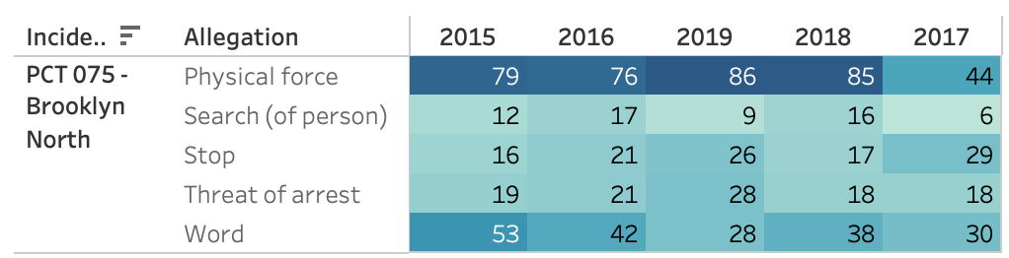
Precinct 075:
From 2011-2019
Amount of Complaints/ Allegations
The highest recurring allegation reported every year was physical force.
Notes:
Looking further into precinct 075—
The variation over the years show to only be slightly significant in 2011 at 579 complaints with the average # of reported incidents being estimated to >500 yearly.
The top precinct and the complaints over 8 years

Slide 10
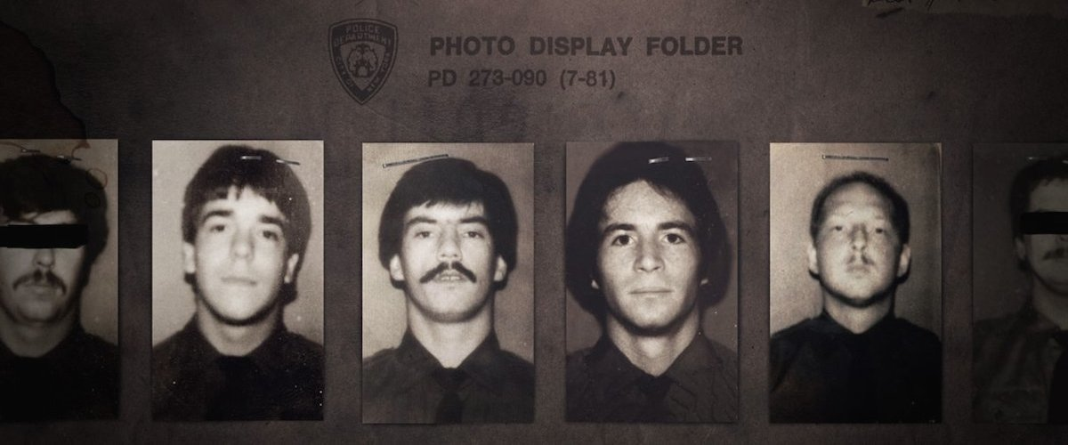
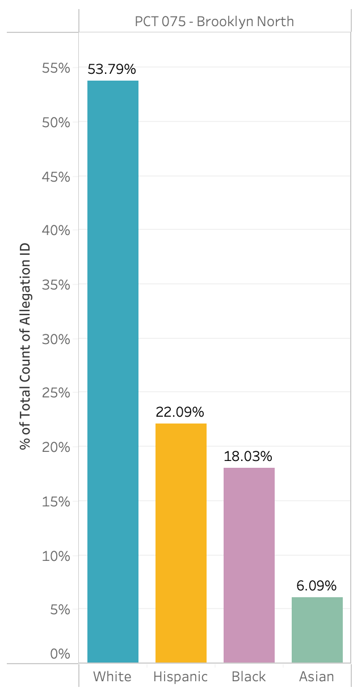
Amount of Allegations
Officer’s Race
Notes:
When dissected even further– data shows that the reported race with the highest # of allegations were white.
White officers were shown to be in the lead during the years 2011-19– it is also noted that the amount of white officers compared to other races are highly significant at 2,092– hispanic - 859– black 701 – asian 237
We discovered a pattern after involving a wider span of locations

Slide 11
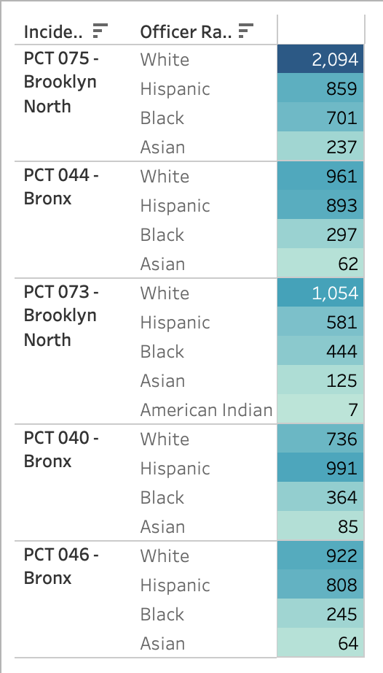
TOP FIVE PRECINCTS
Out of the five precincts, four of these precincts report that white officers received the most complaints
Notes:
Going back to a more broader sense, we looked into the top 5 precincts with the highest amount of reported complaints and broke it down further by the officer’s race.
“Out of the five precincts, four of these show that white officers received the most complaints”

Slide 12
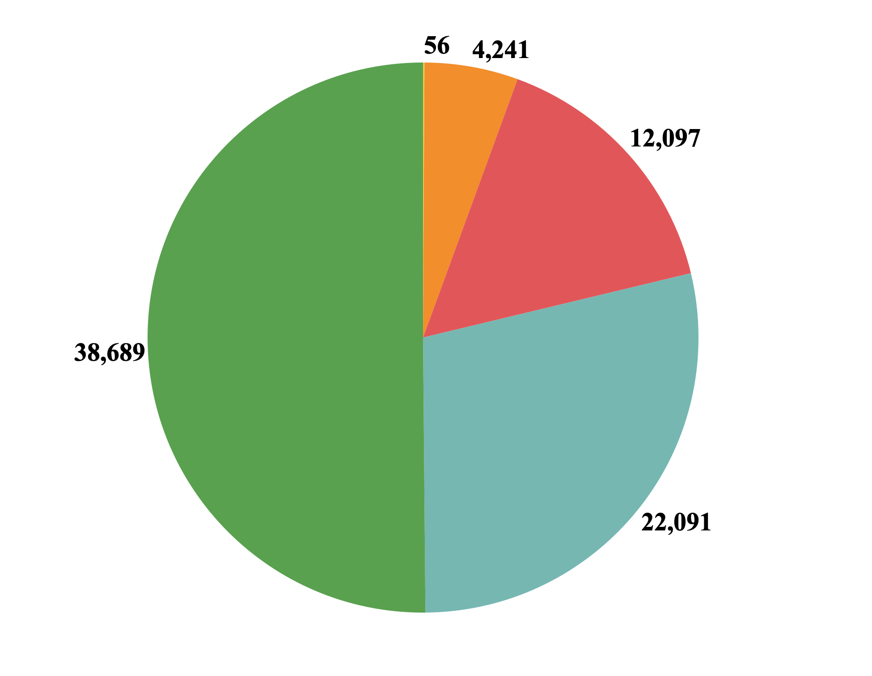
OFFICER’S RACE WITH MOST COMPLAINTS
White Officers cover over 50% among the complaints from civilians from 2011-2019.
American Indian Officers had the least complaints with 56.
Asian
Black
White
Hispanic
Notes:
In this slide, we will look at the race of the officers with the most complaints – According to the pie chart on the right, it shows that
White Officers had the most complaints with over 50.13% of the overall complaints received from 2011-2019
American Indian Officers had the least complaints with 56 complaints.(which is .07% of total)
Hispanic have 28.62%
Black have 15.67%
Asian have 5.50%
As we can see, White officers covers a lot of the complaints , and on the next slide we will see what were the top allegations reported against the white officers

Slide 13
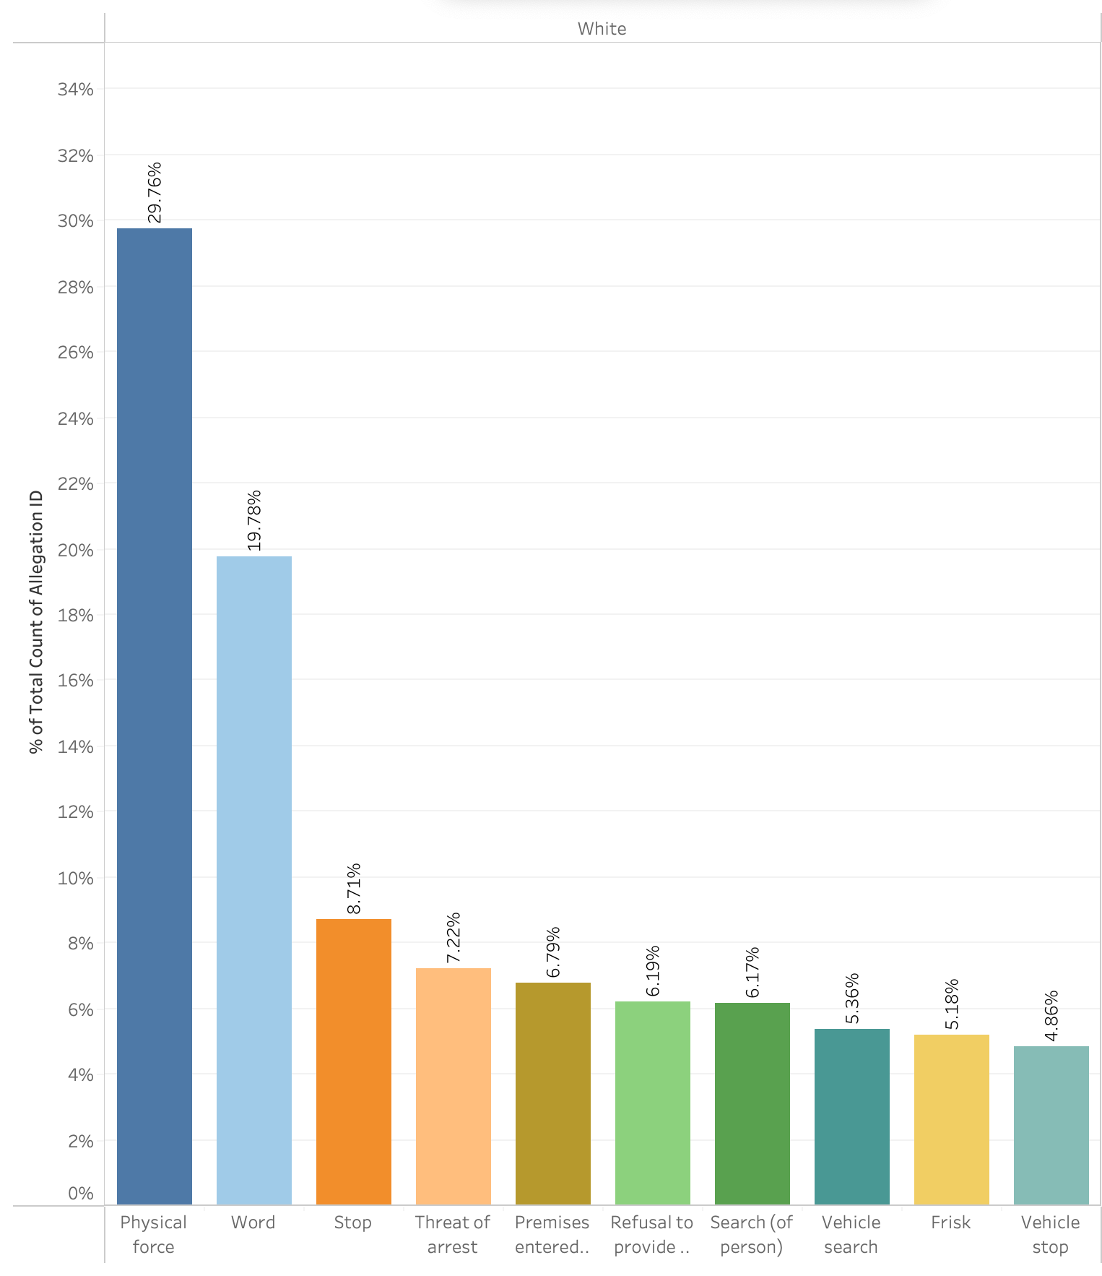
TOP 10 ALLEGATIONS REPORTED AGAINST WHITE OFFICERS
Physical Force: | 29.76% | 7,929
Word: | 19.78% | 5,270
Stop: | 8.71% | 2,320
Threat of Arrest: | 7.22% | 1,924
Premises Entered / Searched: | 6.79% | 1,810
Refusal to Provide Name/Shield #: | 6.19% | 1,649
Search (of person): | 6.17% | 1,645
Vehicle Search: | 5.36% | 1,427
Frisk: | 5.18% | 1,379
Vehicle Stop: | 4.86% | 1,294
Notes:
This bar graph on the slide is showing the top 10 allegations reported against White Officers. And Physical force was the highest allegations reported against white officers with a 29.76%. This is equivalent to 7929 reports from 2011 to 2019. Allegations of offense words is the 2nd highest with 5,270 reports against white officers. The rest of the allegations had similar amount of reports which includes stop (2320) , threat of arrest (1924), premises entered and/or searched (1810), refusal to provide name/shield numbers (1649) , search (of person) (1645), vehicle search (1427), frisk (1379) , and vehicle stop (1294)
And next, I’m going to pass it to Tanvir to talk about the race of whom it impacted

Slide 14
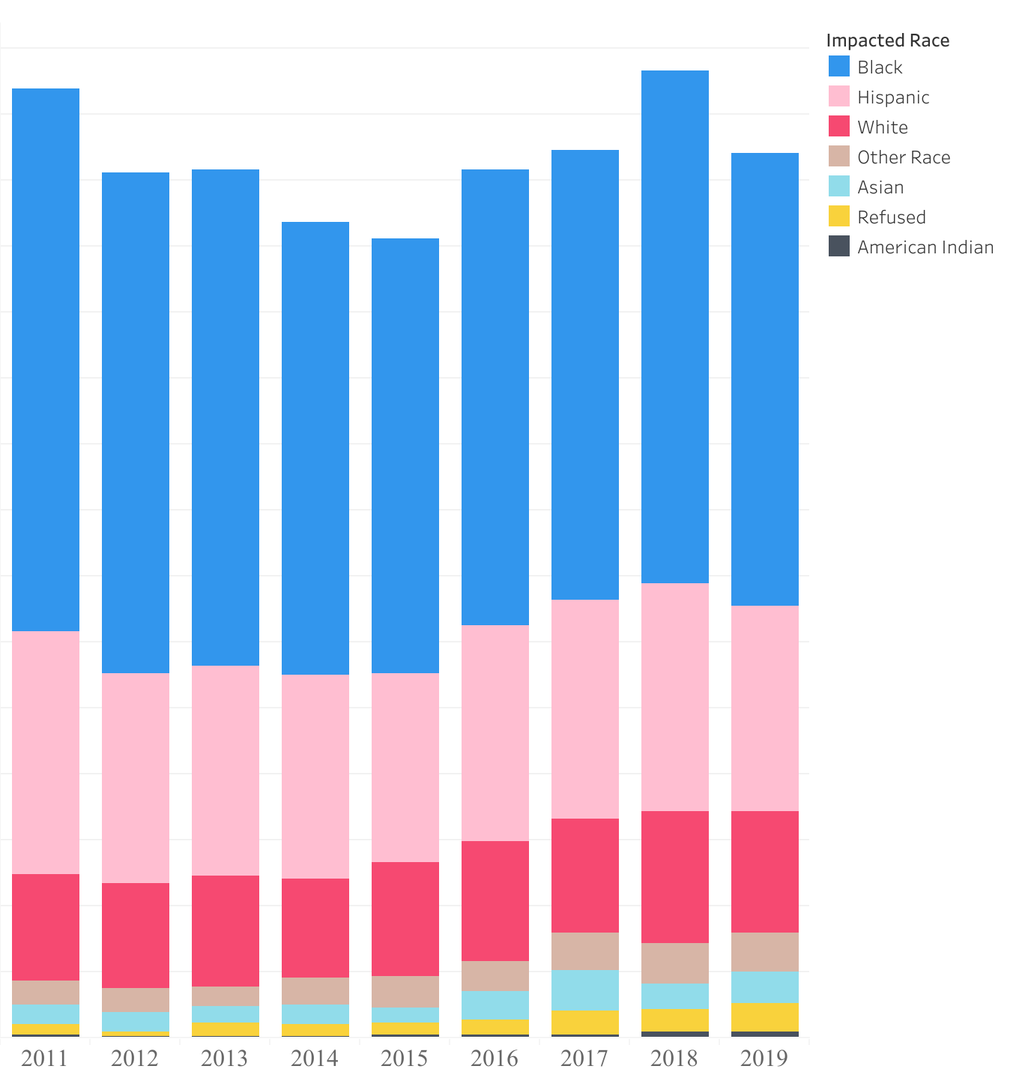
IMPACTED RACE FROM HIGH TO LOW
Notes:
Impacted races (reported) from highest to low
Our data shows, from 2011 to 2019 people who identify as black were revealed to have the most negative experiences based reported incidents. Individuals identifying as hispanic came in second. White shown are the third to be impact.
In 2011, black people covers 6.871% of the complaints and in 2019
black people covers 5.726%
Hispanic people covers 3.057% in 2011 and 2.598% in 2019
White people covers 1.360% in 2011 and 1.532% in 2019
As we can see, black race are the most complaints. In the next slides, we talk about impact gender among the top 7 precincts.

Slide 15
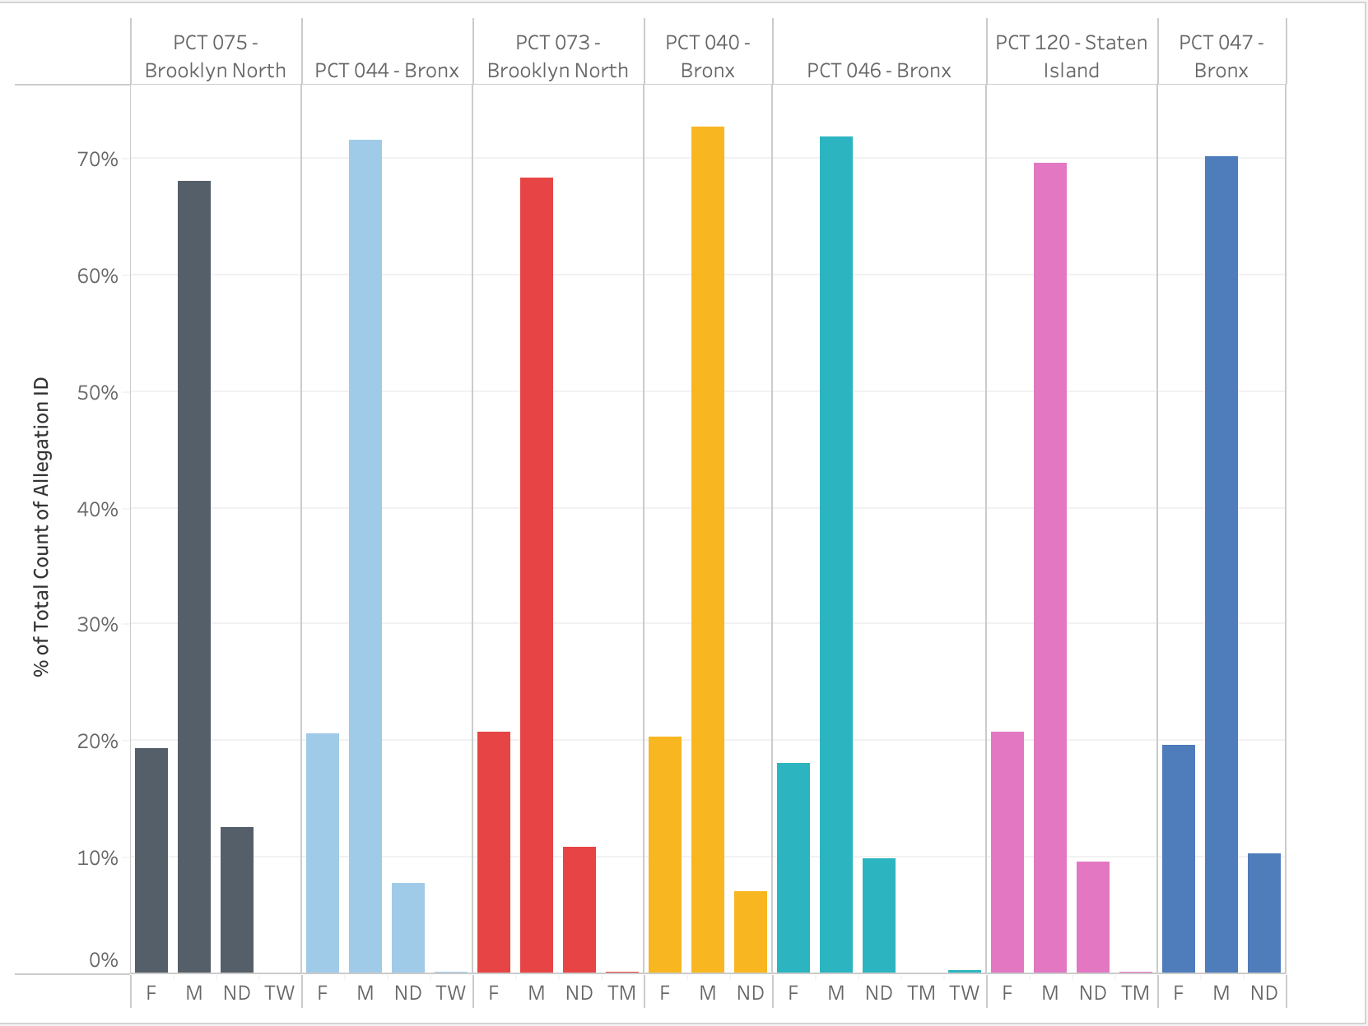
Impacted genders among the top 7 Precincts
F - Female
M - Male
ND - Not Decided
TW - Trans Women
TM - Trans Men
Notes:
In the previous slide, we mention that people who identified as black have reported the most complaints.
More specifically, black males have reported
In this slides, we will be looking at the top 7 precincts and the genders of whom it impacted within the
top 7 precincts.
The majority of the complaints from the top 7 precincts, we found, were made by MALE.
The female to male ratio in the top 7 precincts was approximately 1:3, which indicates that there are three times as many men as women who complain. In the top 7 precincts, male complaints average 68% while female complaints average 20%. According to the reports, this is consistent with the preceding slides, which showed that men and people of color who were black in particular had the worst experiences.
And next, I’m going to pass it to barbara to talk about our recommendations for complaints on nypd.

Slide 16
Our Recommendations

Slide 17
Recommendations
The NYPD must proactively provide New Yorkers with more detailed information on police discipline.
Police recruits should undergo psychological testing to assess their vulnerability to aggressive behavior or moral temptation.
To prevent repetitive wrongdoing, police agencies should promote frequent training for their officers.
The Mayor and City Council must invest in alternative approaches to ensure the safety of the community.

Slide 18
Sources
https://www.kaggle.com/datasets/mrmorj/civilian-complaints-against-nyc-police-officers?select=allegations_202007271729.csv
https://www.apa.org/monitor/2020/10/cover-police-brutality
https://www.nyclu.org/en/campaigns/nypd-discipline-numbers
https://www.ojp.gov/ncjrs/virtual-library/abstracts/why-psychological-screening-police-candidates-necessary-history-and
Raines, J. B. (2010). Ethics in policing: Misconduct and integrity. Jones and Bartlett Publishers.

Slide 19

Thank You!
Any Questions?

